Slide 1
Windows Phone Design Best Practices
Oleksandr Krakovetskyi
CEO, DevRain Solutions, @msugvnua

Slide 2

Microsoft Design Principles

Slide 3

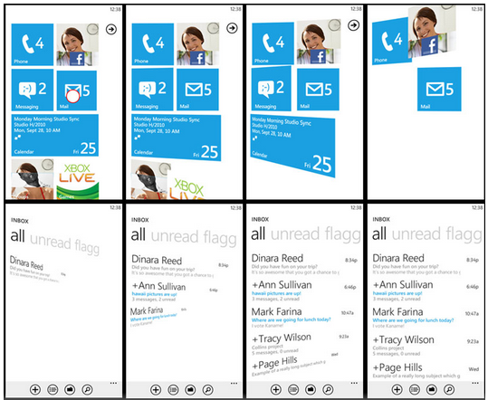
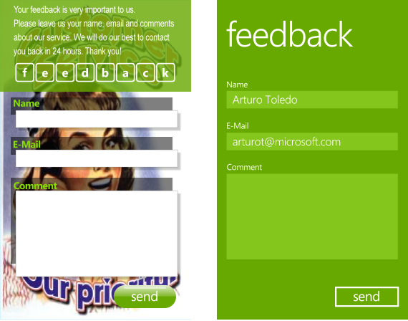
Microsoft design principles
Fast and simple
Authentically digital
Typography
Do more with less (Content Not Chrome)
http://msdn.microsoft.com/en-us/library/windows/apps/hh781237.aspx

Slide 4
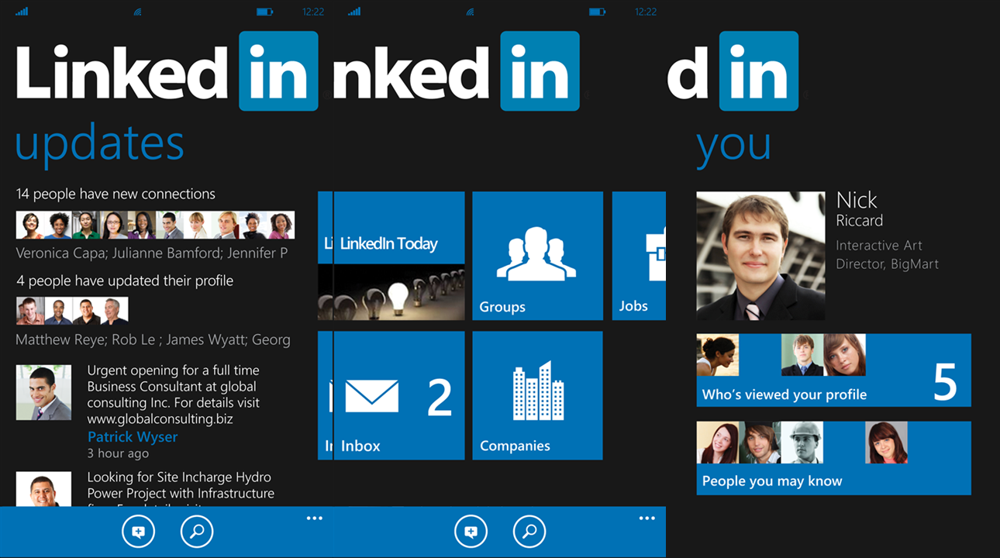
Metro First, brand second

Slide 5

Metro First, brand second

Slide 6
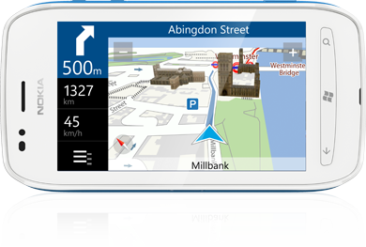
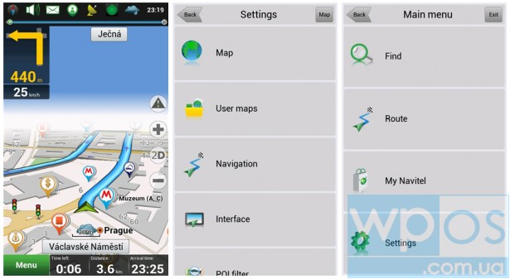
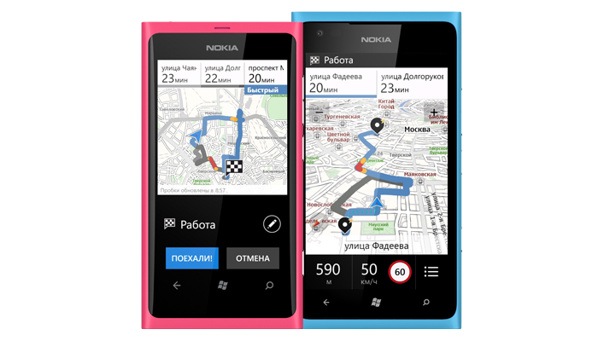
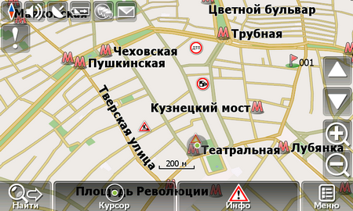
Metro First, brand second

Slide 7
Capitalization
Use lowercase for:
Page titles
List titles
List group titles
Push button control text or words that function as commands
List items
Example text that appears in search boxes
Link controls in the middle of a sentence
Use sentence caps for:
Check box and radio button labels
Progress indicators
Status, notification, and explanatory text
Toggle switches
Use all caps for:
Application titles
Dates and times
AM or PM

Slide 8

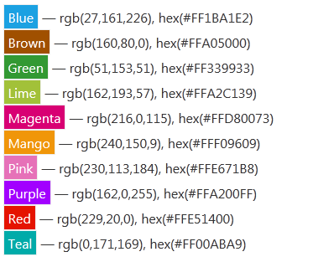
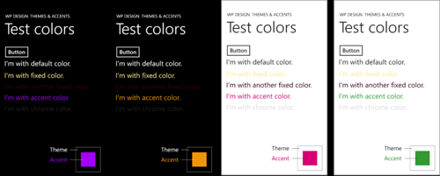
Themes & Accents
// Determine the accent color.
Color currentAccentColorHex =
(Color)Application.Current.Resources["PhoneAccentColor"];

Slide 9
Best Practices

Slide 10
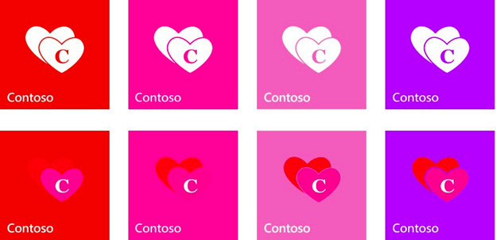

Icons

Slide 11
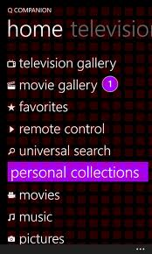
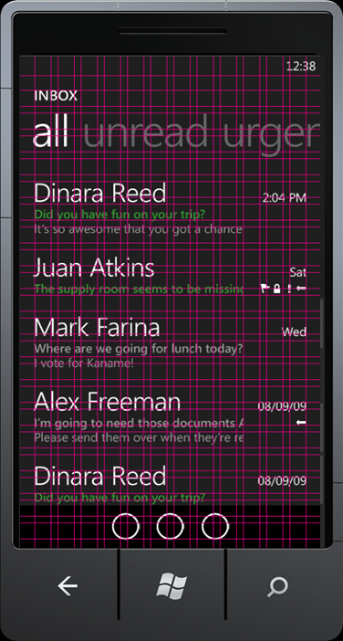
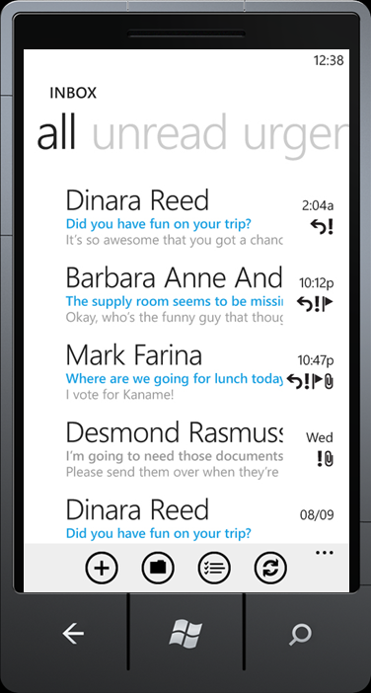
Grid (MetroGridHelper)

Slide 12
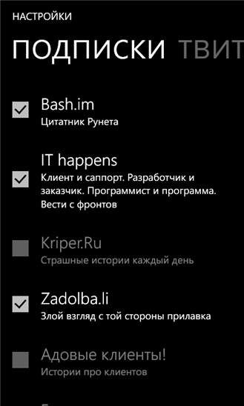
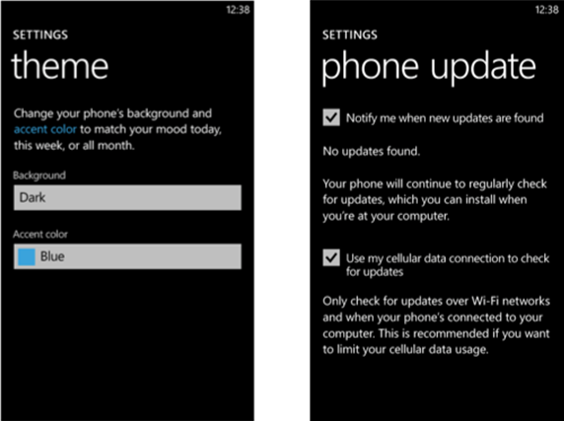
Settings

Slide 13
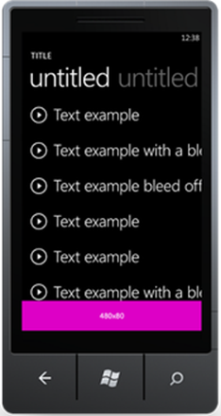
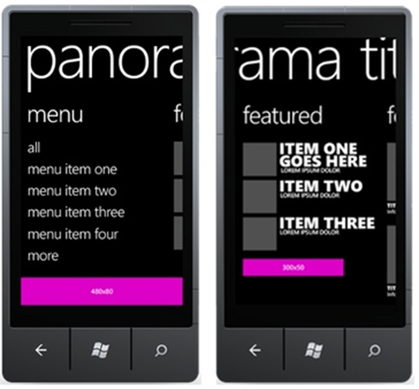
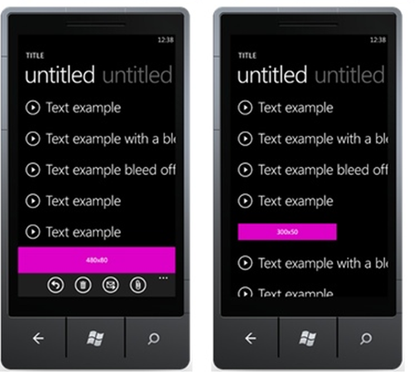
Ads

Slide 14
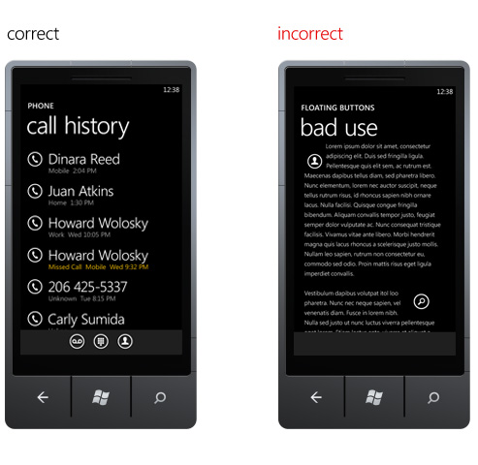
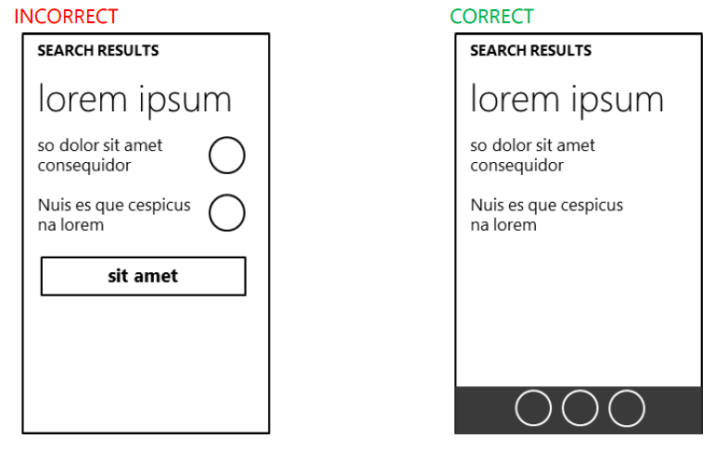
Buttons

Slide 15
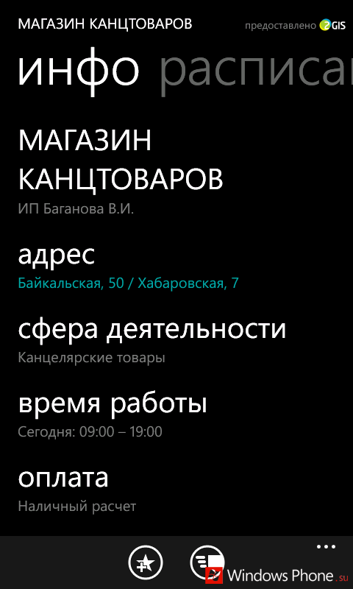
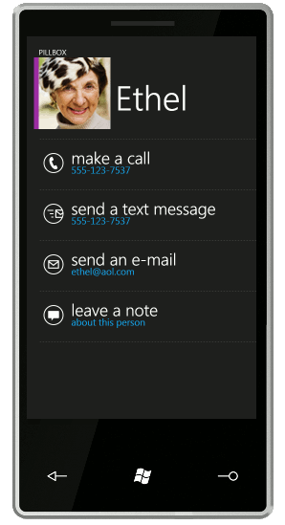
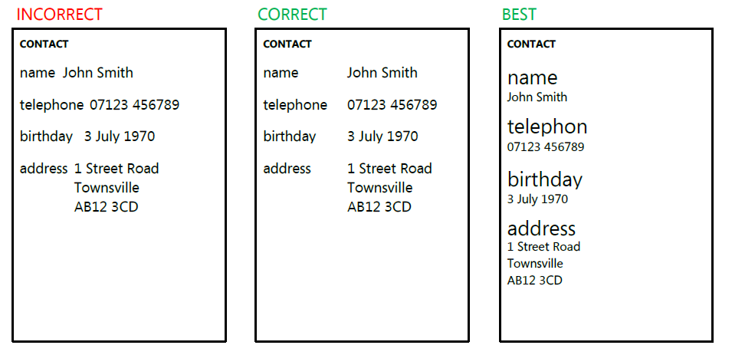
Data

Slide 16
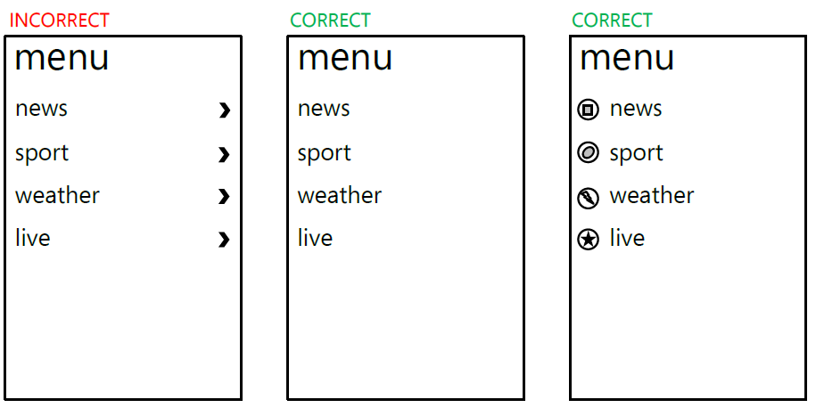
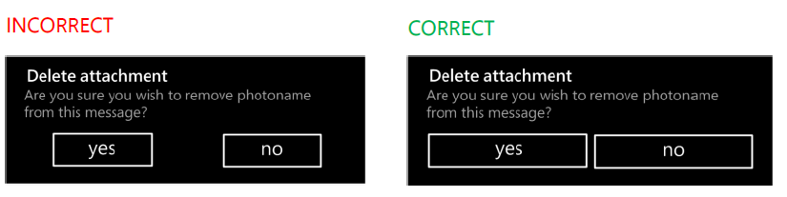
Lists, Notifications

Slide 17
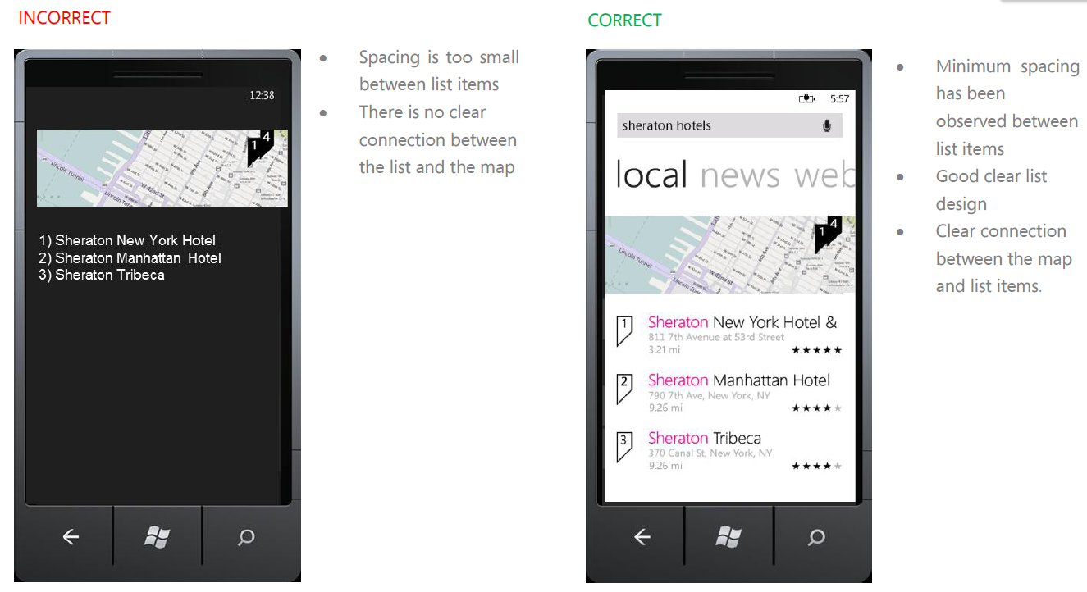
Maps

Slide 18
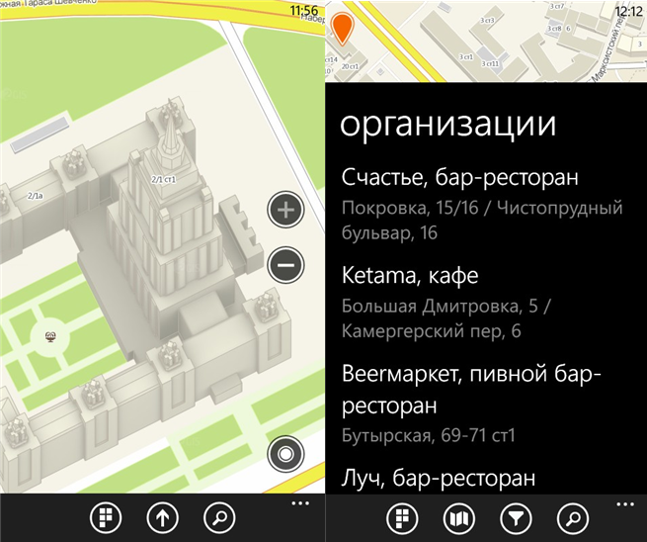
Maps

Slide 19


Contacts
Oleksandr Krakovetskyi
DevRain Solutions
alex.krakovetskiy@devrain.com & @msugvnua
wp7rocks.com & devrain.com

